Slide 1
  Understanding
  Corporate-Value-At-Risk
  (C-VaR)

Slide 2
What is “risk” to a corporate manager?
Is it volatility of earnings/cash flow?
Is it the chance of failing to reach goals or targets?
Is it some sort of probability of a net loss?

Slide 3
Definitions
Porter: “Risk is a function of how poorly a strategy will perform if the ‘wrong’ scenario occurs”
Value at Risk (VaR): “The dollar loss that will be exceeded with a given probability over some given measurement period” – Stulz text

Slide 4
Corporate Risk Management Goals:
Identify Risks.
Measure Risks.
Control Risks.
Corporate-Value-At-Risk (C-VaR) is one methodology that attempts to achieve these goals.

Slide 5
The C-VaR “Big Picture”
Step 1
Identify Risk Factors
Step 3
Forecast/Simulate Risk Factors
Step 4
Compute C-VaR
Map Risk Exposure
Step 2

Slide 6
Step #1: Identify Risk Factors
Foreign Exchange Risk
Interest Rate Risk
Fluctuation in Demand
Commodity Price Risk
A/R Collection Risk

Slide 7
Consider an Income Statement
(Where is it impacted by the risk factors?)
Step #2: Map Risk Exposure
Revenue
Less: (Cost of Goods Sold)
Gross Profit Margin
Less: (Operating Expenses)
EBIT
Less: (Interest Expense)
EBT
Less: (Taxes)
Net Income

Slide 8
Step #2: Map Risk Exposure (cont)
Non-U.S. Rev = ƒ(Currency Risk)
Int Exp = ƒ(Interest Rate Risk)
Rev = ƒ(Fluctuation in Demand)
Costs = ƒ(Commodity Price Risk)
Rev = ƒ(A/R Collection Rate)

Slide 9
Step #3: Forecast / Simulate Risk
What is distribution of each risk factor? (Normal? Lognormal?)
Each sample is a different possible “scenario” of risk outcomes
The 1000 scenarios will form a distribution for C-VaR analysis
Generate random sample of each variable (repeat “x” times –1000?)

Slide 10
Step #4: Compute C-VaR
Use Baseline assumptions for all input variables to calculate benchmark
The dollar loss that will be exceeded with a given probability over some given measurement period is the VaR
Choose a confidence interval to calculate “worst case” scenario

Slide 11
C-VaR Example: FTZ Corporation
Firm Details:
U.S.-based, sales in U.S. & Europe
Sells industrial products made from aluminum
12 month analysis period (Oct 1 – Sept 30)
$80 million investment to be funded with floating-rate, 1-year maturity, debt. Interest paid in arrears, indexed to U.S. 3-month interbank rate (3.33%).
90-day A/R collection period on sales.
Aluminum is bought in advance for next quarter’s production and sale of inventory.

Slide 12
Step #1: FTZ’s Risk Factors
Non-U.S. Sales face exchange rate risk.
Floating-rate debt has fluctuating interest payments.
Price of aluminum can hurt bottom line (increase costs)

Slide 13
Step #2: Map FTZ’s Risk Exposure
Non-U.S. Rev = ƒ(Euro/Dollar)
Int Exp = ƒ(Int Rate Changes)
Costs = ƒ(Aluminum Prices)

Slide 14
Non-U.S. Rev = ƒ(Euro/Dollar)
Forecasts for Exchange Rates & Non-U.S. Revenue (in Euros)
 | Now 9/30 | 4Qtr 12/31 | 1Qtr 3/31 | 2Qtr 6/30 | 3Qtr 9/30
Exchange Rate (€/$) | 0.8011 = X₀ | 0.8668 = X₁ | 0.8753 = X₂ | 0.9300 = X₃ | 0.9610 = X₄
Revenue in Euros | €15,000 | €14,970 | €14,980 | €15,050 | €15,100
90-day lag Collecting Sales |  | €15,000 | €14,970 | €14,980 | €15,050

Slide 15
R_{F} = Foreign Revenue in $
This is what hits the income statement when revenue (sales) is recognized by FTZ (where X is the euro/$ exchange rate)

Slide 16
T = Transaction-related gains or losses on Euro A/R
When cash is collected from customers for their sales, this is when the conversion to $ “really” happens. We must record a gain or loss adjustment to our initial record.

Slide 17
COGS= ƒ(Aluminum Price)
Forecasts for Aluminum Purchases
 | Now 9/30 | 4Qtr 12/31 | 1Qtr 3/31 | 2Qtr 6/30 | 3Qtr 9/30
Purchases in Tons | 15,800 | 15,810 | 15,850 | 15,780
90-day lag for use and Expense Recognition |  | 15,800 | 15,810 | 15,850 | 15,780
Price per Ton | P₀ | P₁ | P₂ | P₃ | P₄

Slide 18
S = Aluminum Cost
These costs are expensed one quarter after the purchases are made (expense recognized when sales occur next quarter).

Slide 19
Int Exp = ƒ(Change in Int Rates)
Schedule of Borrowing, Repayment, & Interest Rates
 | Now 9/30 | 4Qtr 12/31 | 1Qtr 3/31 | 2Qtr 6/30 | 3Qtr 9/30
Cash Flows | +80,000 |  |  |  | -80,000
Interest Rate | R₀ | R₁ | R₂ | R₃
The case says: R0 = 3.33%
But Table I calculates it as 12.01%

Slide 20
I = Interest Expense
R = Floating Rate
Quarterly interest payments are based on interest rates at the end of previous quarter.

Slide 21
Build Benchmark Case
More Assumptions:
US Sales forecasted at $627.613 for year
(4 Qtrs = $169.59, 146.706, $157.849, $153.468)
General Expenses of $404.141 for year
(4 Qtrs =$100.94, 101.036, $101.411, $100.754)
Depreciation Expense of $5.022/qtr
Aluminum assumed stable: $1,395/ton
U.S. 90-day interbank rate stays at 3.33%
  (so FTZ’s cost of debt stays constant at 12.01%)
See Benchmark Case Table I Spreadsheet

Slide 22
Step #3: Forecast Risk Factors
Create “X” random samples (1000) through Crystal Ball or some other Monte Carlo tool
Define each risk factor’s distribution (use mean & standard deviation if normal).
Conduct this process (Step #3) for all 3 of FTZ’s identified risk factors.

Slide 23
Define VaR for Your Purpose
In the FTZ case, C-VaR is defined as the maximum potential shortfall of pre-tax earnings relative to the benchmark of $168.737 million ($168.729 in spreadsheet)
  Maximum is further defined as the 95% worst case earnings result based on a Monte Carlo simulation with 1000 trials

Slide 24
1000 Possible Earnings Outcomes
 | Exchange Rates per Quarter | Aluminum Price per Quarter | Interest Rate per Quarter | Resulting Pretax Earnings per Iteration (1000)
1 |  |  |  | 425.84
2 |  |  |  | 420.73
3 |  |  |  | 415.52
. |  |  |  | .
. |  |  |  | .
. |  |  |  | .
998 |  |  |  | 120.48
999 |  |  |  | 116.83
1000 |  |  |  | 115.35

Slide 25
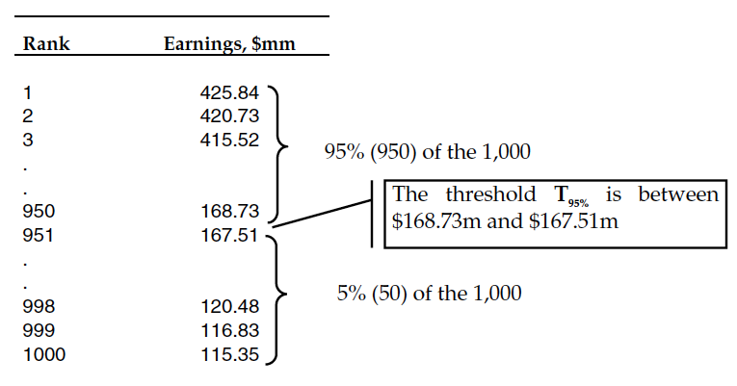
Step #4: Compute C-VaR

Slide 26
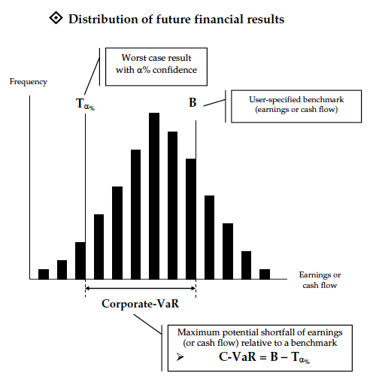
Step #4: Compute C-VaR

Slide 27
Now What???
Is T_{α} really the “worst case” scenario?
How can we reduce C-VaR?
What should management do?
Something, or nothing?
Hedge?

Slide 28
C-VaR’s “Value Added”
Develops risk awareness and improves decision-making
Global view of Risk is formed
Builds strong link between business strategy & risk mgmt

