Slide 1
Student Educational Loan Fund, Inc. (SELF)

Slide 2
What is SELF?
Tax-exempt, separately-incorporated but “related” unit of HBS.
Established in 1961 to fund loans to Harvard Business School (HSB) students.
The endowment of HBS needs to loan money. Selling the loans away helps free up money.
HBS indirectly backs SELF by investing in its capital and providing a “comfort letter.”

Slide 3
How does SELF currently operate?
They buy loans from HBS Student Loan Program (loans made to students at the start of each semester).
Loan rates are floating -- reset twice a year, late May and late November (based on SELF’s cost of capital over the prior 6-months).
Interest accrues while student in school, but no payments required until 6 months after graduation.
Set repayment schedule (max 5 years). Left a large balloon payment at end for large debtors.

Slide 4
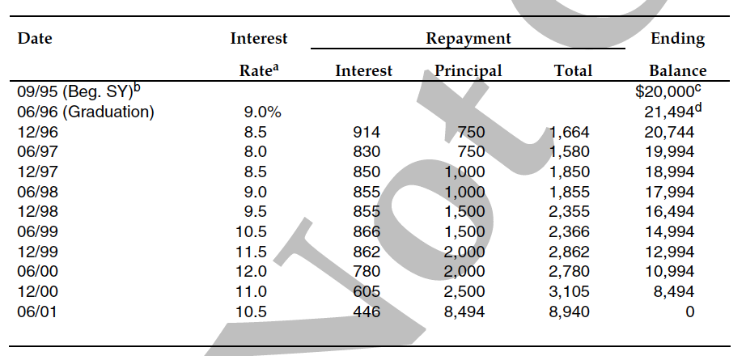
Example of Current Payment Schedule

Slide 5
What risks does SELF currently face?
Default Risk – Students may not be able to pay back loans in part or full. (Foreign students and students that have already tapped out other federal sources of loans).
Interest Rate Risk? (Minimal… interest rate on funding loans are floating and so are payments received from students – but what about the smoothing of their rates? Maybe a loss leader?).
Prepayment Risk – Students can pay back their loans early without any penalty.
Other Risk – Lack of available data from Holyoke (processing center outside SELF).

Slide 6
Do they have risk management techniques already in place?
They limit the borrowing to $25,000, provided their total MBA-related debt would not exceed $62,000 at graduation.
Their funding sources (liabilities) and student loans (assets) are both floating.
Credit check made, (but no co-applicant needed).
Must have gone through other sources of funding first (credit trail).

Slide 7
The New Proposal (Why/What)
Students unhappy with the repayment schedule.
Semi-annual with balloon payment is hard to manage.
Other financing for these students is difficult because other institutions can’t understand loan structure.
While not stated, students probably want the certainty of a locked in fixed rate.
New Proposal: Amortized monthly payments upon graduation with a fixed rate. (show calculations)
Fixed rate determined upon graduation (so different graduates could have different rates based on year).

Slide 8
Amortization Calculations
PV = $21,494; N = 5 x 12; I = 9%/12; CPT PMT: $446.19 per month for 5 years.

Slide 9
Updated Risk Assessment
Default Risk? Perhaps lessened, as students pay monthly, which coincides with income. Perhaps SELF will detect payment problems earlier and address them with students.
Interest Rate Risk? – New Problem Caused (Service Management fixed, Financing Problem caused)
Prepayment Risk? (made worse!) With the fixed rates, if interest rates go down, students are more likely to refinance.
Other Risk? Still have Holyoke processing concerns.

Slide 10
(Assume Proposed Fixed Loans Start) Risk Management Alternatives:
Do nothing
Fixed for Floating Interest Rate Swap
Interest Rate Cap
Interest Rate Floor

Slide 11
Proposed Situation (Do Nothing)
Receive Fixed
Student
Loans
Rate = Fixed
SELF
Pay Floating
Current Bank Lines of Credit
(Prime = 8.75% currently)

Slide 12
Consider a Swap
Notional Amount: $10 million
Maturity: 5 years
Payment Frequency: Monthly
SELF receives: 1-mo $U.S. LIBOR
SELF pays: 5.76% per annum

Slide 13
The Swap Mechanics
Receive Fixed
Swap: Receive Floating LIBOR
Student
Loans
Rate =
Fixed
SELF
SWAP
Bank
Swap: Pay Fixed 5.76%
Pay Floating PRIME
Current Bank Lines of Credit
(Prime = 8.75% currently)

Slide 14
Basis Swap
Notional Amount: $10 million
Maturity: 5 years
Payment Frequency: Monthly
SELF pays: 1-mo $U.S. LIBOR
SELF receives: Prime – 2.80%
Note that this forecasts Prime to be 2.8%> LIBOR
Prime is currently 2.93%> LIBOR
Problem Solved: LIBOR vs. PRIME

Slide 15
The Swap Mechanics: Basis Swap
Receive Fixed
Swap: Receive PRIME – 2.8%
Student
Loans
Rate =
Fixed
SELF
SWAP
Bank
Swap: Pay LIBOR
Pay Floating PRIME
Current Bank Lines of Credit
(Prime = 8.75% currently)
Net Cost
Pay | PRIME
Pay | LIBOR
Receive | (PRIME-2.8%)
Net Cost | LIBOR +2.8%

Slide 16
The Swap Mechanics: Basis Swap & Regular Swap
Receive Fixed
Swap: Receive LIBOR
Student
Loans
Rate =
Fixed
SELF
SWAP
Bank
Swap: Pay Fixed 5.76%
Pay Floating LIBOR + 2.8%
Current Bank Lines of Credit
(Converted to LIBOR + 2.8%)
Net Cost
Pay | LIBOR + 2.8%
Pay | 5.76%
Receive | (LIBOR)
Net Cost | 8.56%

Slide 17
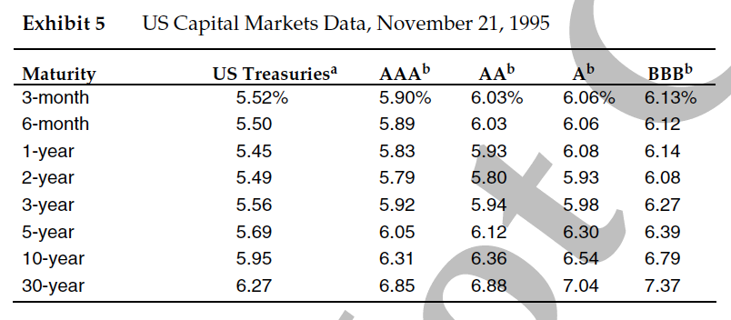
Cost of the Swap
How does the net cost of 8.56% compare?

Slide 18
Pre-payment Risk
Does the Swap solve the pre-payment risk problem?
No.
How is the pre-payment ability like an option? Who owns the pre-payment “option?”
Borrowers have a long call option to buy the loan back from SELF at par at any time.
When are borrowers likely to exercise this option?
When interest rates fall.
How can we reduce pre-payment risk?
Could put in penalties, or have monthly floating payments (but probably contrary to goal of making students happy).

Slide 19
Pre-payment Risk Solution #1
Conduct the basis swap and interest rate swap to secure fixed rate liabilities (a double swap!)
Buy a floor (the right to sell funds at a set interest rate). This is like a long put.
It will be in the money if interest rates go down – which is when the students are most likely to refinance

Slide 20
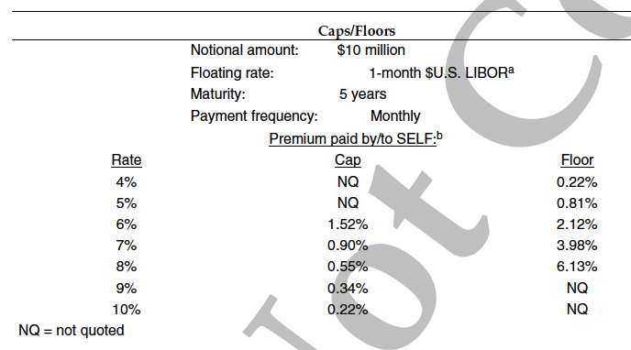
Option Quotes given in Case:

Slide 21
Pre-payment Risk Solution #2
Conduct the basis swap only (swap Prime for LIBOR) and continue to borrow at floating rates.
Receive fixed payments from students
Make payments at LIBOR (not Prime)
Buy a cap (the right to borrow funds at a set interest rate)
In the money if interest rates go up, so it protects the LIBOR payments SELF must make
Pre-payment risk still exists, but is somewhat compensated for with lower payments SELF makes on its LIBOR loan

Slide 22
Option Quotes given in Case:

Slide 23
Outcome
The SELF board decided to adopt the monthly-pay fixed-rate student loan structure in 1996.
They decided to choose the last option we discussed:
They did not enter a double swap. They decided to only do a basis swap – not a variable-for-fixed swap
They solicited bids from banks for the basis swap and a 7% cap.

