Slide 1
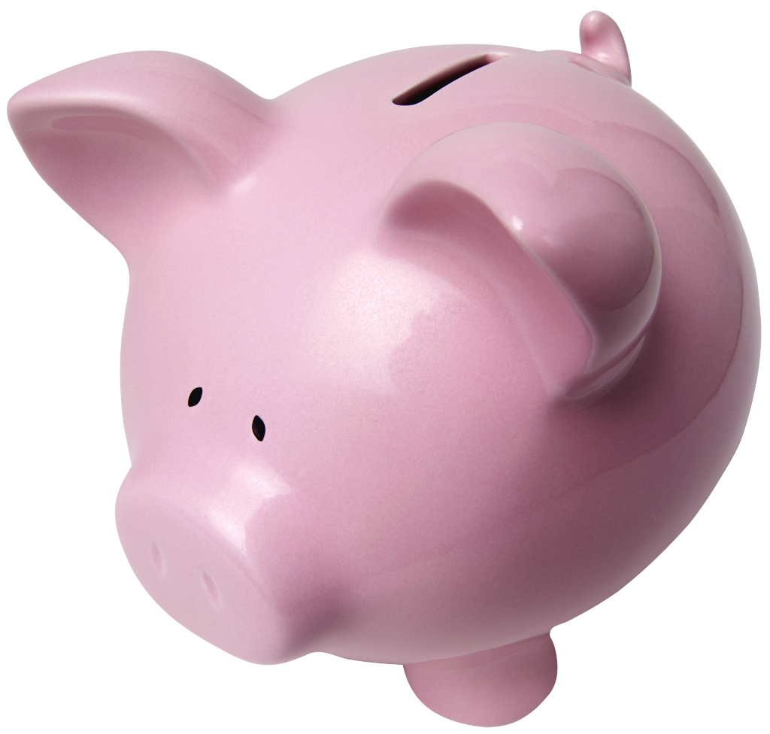
Swaps
Interest Rate Swaps
Mechanics

Slide 2
Interest Rate Swaps
Now let’s turn to another investment vehicle that is used to manage interest rate risk… Interest Rate Swaps.
Key Factors:
Fixed-Rates: Ex: 8.75%, 10%, 12%
Variable-Rates (floating): Ex: LIBOR+1%, PRIME +2%

Slide 3
Fixed vs. Variable (floating)
Suppose IBM has the following assets and liabilities on its books:
Assets:
$20 million in variable-rate financing (loans) at LIBOR (London InterBank Offer Rate) +1%, made to customers purchasing IBM computers.
Liabilities:
$20 million in 5% fixed-rate, annual paying bonds that were issued to fund the above financing program.

Slide 4
Fixed vs. Variable (floating)
What do the IBM cash flows look like?
Assets:
Interest Income (inflow) to IBM dependent upon the interest rate environment. (LIBOR+1%)
Liabilities:
Interest Expense (outflow) for IBM is fixed, based on the coupon rate of the bonds. (5%)
IBM’s concerns:
What would happen if market interest rates shot up? (Income up, expenses same – this is good!)
What would happen if market interest rates fell? (Income down, expenses same – this is bad!)

Slide 5
IBM’s Cash Flows
Period (years) | LIBOR | Floating Interest Income | Fixed Interest Expense | Net Interest Flow
Today | 4.00% | $20 million x (LIBOR +1%) | $20 million bonds at 5% coupon, annual
1 | ?? | $1,000,000 | ($1,000,000) | 0
2 | ?? | ?? | ($1,000,000) | ??
3 | ?? | ?? | ($1,000,000) | ??
4 | ?? | ?? | ($1,000,000) | ??
5 | ?? | ?? | ($1,000,000) | ??
6 | ?? | ?? | ($1,000,000) | ??
(4% + 1%)x20 mill = 1 million

Slide 6
IBM’s Cash Flows (increasing interest rates)
Period | LIBOR | Floating Interest Income | Fixed Interest Expense | Net Interest Flow
Today | 4.00% | $20 mil x (LIBOR +1%) | $20 million bonds at 5% coupon, annual
1 | 4.20% | $1,000,000 | ($1,000,000) | $0
2 | 4.40% | $1,040,000 | ($1,000,000) | $40,000
3 | 5.00% | $1,080,000 | ($1,000,000) | $80,000
4 | 5.60% | $1,200,000 | ($1,000,000) | $200,000
5 | 5.90% | $1,320,000 | ($1,000,000) | $320,000
6 | 6.40% | $1,380,000 | ($1,000,000) | $380,000
End of Period 2 income:
(4.2%+1%)x20mill= $1,040,000.
Note the delay in the rate change effect.

Slide 7
IBM’s Cash Flows (decreasing interest rates)
Period | LIBOR | Floating Interest Income | Fixed Interest Expense | Net Interest Flow
Today | 4.00% | $20 mil x (LIBOR +1%) | $20 million bonds at 5% coupon, annual
1 | 3.90% | $1,000,000 | ($1,000,000) | $0
2 | 3.70% | $980,000 | ($1,000,000) | ($20,000)
3 | 3.50% | $940,000 | ($1,000,000) | ($60,000)
4 | 3.40% | $900,000 | ($1,000,000) | ($100,000)
5 | 3.00% | $880,000 | ($1,000,000) | ($120,000)
6 | 2.90% | $800,000 | ($1,000,000) | ($200,000)
End of Period 2 income:
(3.7%+1%)x20mill= $940,000.
Note the delay in the rate change effect.

Slide 8
How can IBM match these cash flows?
They could refinance their fixed-rate liabilities with floating-rate liabilities:
Issue new bonds with a variable rate structure that is similar to that of the assets (LIBOR + 1% assets).
Use the proceeds to call the fixed-rate bonds (if callable), or to purchase them in the market to retire them.
But, this can be very expensive (flotation costs) and time consuming.
Instead, IBM could enter the Swap Market and purchase an investment vehicle, called an Interest Rate Swap, that allows them to, in effect, change a stream of cash flows from fixed to variable (or vice versa).

Slide 9
Swaps Contracts: Definitions
In a Swap, two counter-parties agree to a contractual arrangement wherein they agree to exchange cash flows at periodic intervals.
Fixed for Floating; Floating for Fixed
Only interest payments are swapped. No Principal is exchanged
Single currency interest rate swap
“Plain vanilla” fixed-for-floating swaps are often just called interest rate swaps.

Slide 10
Swaps Contracts: Definitions
Notional Amount: Amount used to calculate the swapped interest payments.
Fixed-rate payer (buyer): Person who pays fixed is always the buyer
Floating-rate payer (seller): Person who pays floating is always the seller
Reset Date: When the floating rate changes
Counterparty-risk: Risk that one party might default. Party who is left will have to find a new counterparty at prevailing swap rates.

Slide 11
The Swap Bank
A Swap Bank is a generic term to describe a financial institution that facilitates Swaps between counter-parties.
The Swap Bank can serve as either a broker or a dealer.
As a broker, the Swap Bank matches up counter-parties but does not assume any of the risks of the swap.
As a dealer (market-maker), the Swap Bank stands ready to accept either side of a swap. They, in fact, are then the counter-party and they assume risk. Later, they can match the swap with another counter-party to alleviate exposure to counterparty risk.

Slide 12
How do Swap Banks make their money?
They can charge a commission if they act as a broker (they take on no counter-party risk). They just match up Firm A and Firm B that have offsetting cash flow needs (fixed vs. floating). (ex: match IBM with a firm with opposite floating vs. fixed rate needs)
They can act as a dealer and actually play the role of counter-party on a SWAP. They set the swap rates so that they expect to earn a profit if they are the counter party for both sides. (ex: Swap Bank enters into swap directly with IBM)

Slide 13
Let’s get back to IBM’s problem…
Currently:
$20,000,000 fixed-rate liabilities, 5% fixed outflows
$20,000,000 floating-rate assets, LIBOR+1 inflows
What if IBM entered into a transaction whereby they could….
Receive 5% fixed inflows on $20 million
(in exchange for…)
Paying LIBOR+1 outflows on $20 million
This is what a SWAP could accomplish.

Slide 14
IBM’s Cash Flows with a SWAP
 | Current Assets/Liabilities |  |  |  | Sell a SWAP (pay floating, receive fixed)
Period (years) | LIBOR | Floating Interest Income | Fixed Interest Expense |  | SWAP Fixed Income | SWAP Floating Expense | Net Interest Flow
0 | 4.00% | $20mil* (LIBOR +1%) | $20 million bonds at 5% coupon, annual |  | 5% on $20,000,000 notional amount | $20mil* (LIBOR +1%)
1 | ?? | $1,000,000 | ($1,000,000) |  | $1,000,000 | ($1,000,000) | $0
2 | ?? | ?? | ($1,000,000) |  | $1,000,000 | ?? | $0
3 | ?? | ?? | ($1,000,000) |  | $1,000,000 | ?? | $0
4 | ?? | ?? | ($1,000,000) |  | $1,000,000 | ?? | $0
5 | ?? | ?? | ($1,000,000) |  | $1,000,000 | ?? | $0
6 | ?? | ?? | ($1,000,000) |  | $1,000,000 | ?? | $0

Slide 15
An Example of an Interest Rate Swap
Consider this example of a “plain vanilla” interest rate swap.
Bank A (not a swap bank) is a AAA-rated U.S. bank that has raised $10,000,000 in fixed-rate coupon-paying bonds to finance floating-rate mortgage loans.
Bank A used 5-year fixed-rate coupon bonds at 10%.
Due to changes in the interest rate environment, Bank A wants to have floating-rate notes at LIBOR to finance their floating-rate mortgage loans.
Bank A could refinance its debt by reissuing $10 million in floating LIBOR bonds (and pay associated flotation costs).

Slide 16
An Example of an Interest Rate Swap
Firm B is a BBB-rated U.S. company that needed $10,000,000 to finance an investment with a five-year economic life.
Firm B used 5-year floating-rate notes at LIBOR + ½%.
Firm B wants to manage their risk by changing their liabilities to a fixed-rate structure. With their credit rating, they can get 5-year fixed rate coupon bonds at 11.75%.
Firm B could refinance its debt by issuing $10 million fixed 11.75% coupon bonds (and pay associated flotation costs).

Slide 17
An Example of an Interest Rate Swap
The borrowing opportunities of the two firms are:
 | Bank A | Firm B
Currently has… | 10% Fixed | LIBOR + ½% Floating
Would like/ Could Get… | LIBOR Floating | 11.75% Fixed

Slide 18
A Swap Bank comes along…
Swap
Bank
The Swap Bank makes this offer to Bank A:
You pay LIBOR – 1/8 % per year on $10 million for 5 years and we will pay you 10 3/8% on $10 million for 5 years (a swap).
Is this a good offer for Bank A?
10 3/8%
LIBOR – 1/8%
Bank
A
Swap bank is the Buyer

Slide 19
Bank A’s Borrowing Position
Period (years) | Current Fixed Interest Expense |  | SWAP Fixed Income | SWAP Floating Expense |  | Net Borrowing Rate
0 | $10 million bonds at 10% coupon, annual |  | 10 3/8% on $10,000,000 notional amount | $10 million notional amount x (LIBOR -1/8%)
1 | (10%) |  | 10.375% | (LIBOR – 0.125%) |  | (LIBOR – 0.50%)
2 | (10%) |  | 10.375% | (LIBOR – 0.125%) |  | (LIBOR – 0.50%)
3 | (10%) |  | 10.375% | (LIBOR – 0.125%) |  | (LIBOR – 0.50%)
4 | (10%) |  | 10.375% | (LIBOR – 0.125%) |  | (LIBOR – 0.50%)
5 | (10%) |  | 10.375% | (LIBOR – 0.125%) |  | (LIBOR – 0.50%)
Net Cost
Pay | 10%
Pay | LIBOR-0.125%
Receive | (10.375%)
Net Cost | LIBOR – 0.50%
 | Bank A | Firm B
Currently has… | 10% Fixed | LIBOR+ ½ % Floating
Would like/ Could Get… | LIBOR Floating | 11.75% Fixed

Slide 20
Bank A Summary
Swap
Bank
Here’s what’s in it for Bank A: They borrow externally at 10% fixed and have a net borrowing position of :
[LIBOR – 1/8] +10 - 10 3/8 = LIBOR – ½ %
which is ½ % better than they can borrow floating without a swap.
10 3/8%
LIBOR – 1/8%
Bank A
10%
½% of $10,000,000 = $50,000. That’s quite a cost savings per year for 5 years as opposed to refinancing. Not to mention the flotation costs that were avoided.

Slide 21
Now the Swap Bank talks to Firm B
The Swap Bank makes this offer to Firm B:
You pay us 10 ½% fixed per year on $10 million for 5 years and we will pay you LIBOR – ¼% per year on $10 million for 5 years (a swap).
Is this a good offer for Firm B?
Swap
Bank
10 ½%
LIBOR – ¼%
Firm B
Firm B is the Buyer

Slide 22
Firm B’s Borrowing Position
Period (years) | Current Floating Int. Expense |  | SWAP Floating Income | SWAP Fixed Expense |  | Net Borrowing Rate
0 | $10 million bonds at LIBOR+1/2% |  | $10 million notional x (LIBOR - ¼%) | $10 million notional amount x 10 ½ %
1 | (LIBOR + 0.50%) |  | LIBOR – 0.25% | (10.50%) |  | (11.25%)
2 | (LIBOR + 0.50%) |  | LIBOR – 0.25% | (10.50%) |  | (11.25%)
3 | (LIBOR + 0.50%) |  | LIBOR – 0.25% | (10.50%) |  | (11.25%)
4 | (LIBOR + 0.50%) |  | LIBOR – 0.25% | (10.50%) |  | (11.25%)
5 | (LIBOR + 0.50%) |  | LIBOR – 0.25% | (10.50%) |  | (11.25%)
Net Cost
Pay | LIBOR + 0.50%
Pay | 10.50%
Receive | (LIBOR – 0.25%)
Net Cost | 11.25%
 | Bank A | Firm B
Currently has… | 10% Fixed | LIBOR+ ½ % Floating
Would like/ Could Get… | LIBOR Floating | 11.75% Fixed

Slide 23
Firm B Summary
Here’s what’s in it for Firm B. They borrow externally at LIBOR + ½ % and have a net borrowing position of
10½ + [LIBOR + ½ ] – [LIBOR - ¼ ] = 11.25%
which is ½% better than they can borrow fixed.
Swap Bank
10 ½%
LIBOR – ¼%
LIBOR + ½%
Firm B
½% of $10,000,000 = $50,000. That’s quite a cost savings per year for 5 years as opposed to refinancing. Not to mention the flotation costs that were avoided.

Slide 24
What about the Swap Bank?
The Swap Bank makes money too.
Swap Bank
10 3/8%
10 ½%
LIBOR – 1/8%
LIBOR – ¼%
Bank A
Firm B
Revenues - Expenses
[LIBOR – 1/8%] – [LIBOR – ¼% ] = 1/8%
10 ½ - 10 3/8 = 1/8%
=1/4 %
¼% of $10 million = $25,000 per year for 5 years.

Slide 25
Everybody’s happy…
The Swap Bank makes ¼%
Swap
Bank
10 3/8%
10 ½%
LIBOR – 1/8%
LIBOR – ¼%
Bank
A
Firm
B
LIBOR + ½%
10%
Bank A saves ½% and matches up floating assets with floating liabilities
Firm B saves ½% and matches up fixed assets with fixed liabilities

Slide 26
Swap Quotes
How is the fixed part of a Swap quoted by the dealer?
Based on the 5-year Treasury Note rate and LIBOR
“50 – 75” means that the Swap Bank is willing to buy a Swap (pay fixed) for T-note rate + 50 basis points, and/or sell a Swap (received fixed) for T-note rate + 75 basis points.
If the current T-note rate is 10%, the “50-75” quote would mean the Swap Bank would pay fixed at 10.50% for LIBOR and receive fixed at 10.75% for LIBOR.
It is easy enough to add or subtract basis points from each side as needed.

Slide 27
What was the Fixed Quote for the Swap Bank in our example?
Swap
Bank
10 3/8%
10.5%
LIBOR – 1/8%
LIBOR – ¼%
Bank
A
Firm
B
LIBOR + ½%
10%
Suppose the 5-year T-note rate was 10%...
Pay 10.50% and Receive 10.75% on LIBOR (50 – 75 quote). Subtract 1/8% from each side with bank A. Subtract ¼% from each side with bank B

Slide 28
Swap Example (Part 1):
Hi-Gear, Inc., a manufacturer of sportswear recently issued a 10-year, $5 million bond issue. The bond requires a fixed rate of 8.5% per year (annual payments).
The CFO of Hi-Gear would prefer to have a floating-rate liability.
The CFO decides to hedge by entering into an interest rate swap, where the firm would receive fixed and pay floating. The Swap dealer quotes 10-year Swaps as LIBOR based, “80-87”. The current 10 year Treasury Bond yield is 7%.

Slide 29
Hi-Gear’s Borrowing Environment (Receive fixed and pay floating. The Swap dealer quotes 10-year Swaps as LIBOR based, “80-87”.)
Fixed 7.8%
Hi-Gear, Inc.
Swap Bank
Floating (LIBOR)
Questions:
Who is the buyer? The Swap Bank
What is the net borrowing position of Hi-Gear, Inc.?
8.5% Fixed
Current Bond Holders
Net Cost
Pay | 8.5%
Pay | LIBOR
Receive | (7.80%)
Net Cost | LIBOR +0.70%

Slide 30
Swap Example (Part 2):
Lo-Gear, Inc., a manufacturer of sportswear recently issued a 10-year, $20 million bond with a LIBOR + 2% floating rate.
The CFO of Lo-Gear would prefer to have a fixed-rate liability.
The CFO decides to hedge by entering into an interest rate swap, where the firm would receive floating and pay fixed. The Swap dealer quotes 10-year Swaps as LIBOR based, “80-87”. The current 10 year Treasury Bond yield is 7%.

Slide 31
Lo-Gear’s Borrowing Environment (Receive floating and pay fixed. The Swap dealer quotes 10-year Swaps as LIBOR based, “80-87”.)
Floating LIBOR
Lo-Gear, Inc.
Swap Bank
Fixed 7.87%
Questions:
Who is the buyer? Lo-Gear
What is the net borrowing position of Lo-Gear, Inc.?
LIBOR +2%
Current Bond Holders
Net Cost
Pay | LIBOR +2%
Pay | 7.87%
Receive | (LIBOR)
Net Cost | 9.87%

Slide 32
Basis Swap (Used to effectively change the base of a floating loan)
Receive PRIME-3%
GE
Swap Bank
Pay LIBOR
Suppose GE currently has a loan outstanding that is PRIME + 2%.
A Basis Swap can “change” the base of its floating rate loan from PRIME to LIBOR.
Example: Pay LIBOR, Receive PRIME – 3%
PRIME +2%
Current Bond Holders
Net Cost
Pay | PRIME +2%
Pay | LIBOR
Receive | (PRIME-3.0%)
Net Cost | LIBOR +5.0%

