Slide 1
Integrated Risk Management

Slide 2
Case Summary
What is the problem at hand?
New Proposal to provide combined protection against several risks, including currency exposure and traditionally-insurable risks.
First step in an integrated “enterprise” risk management program.
Should the Finance Committee approve the proposal?

Slide 3
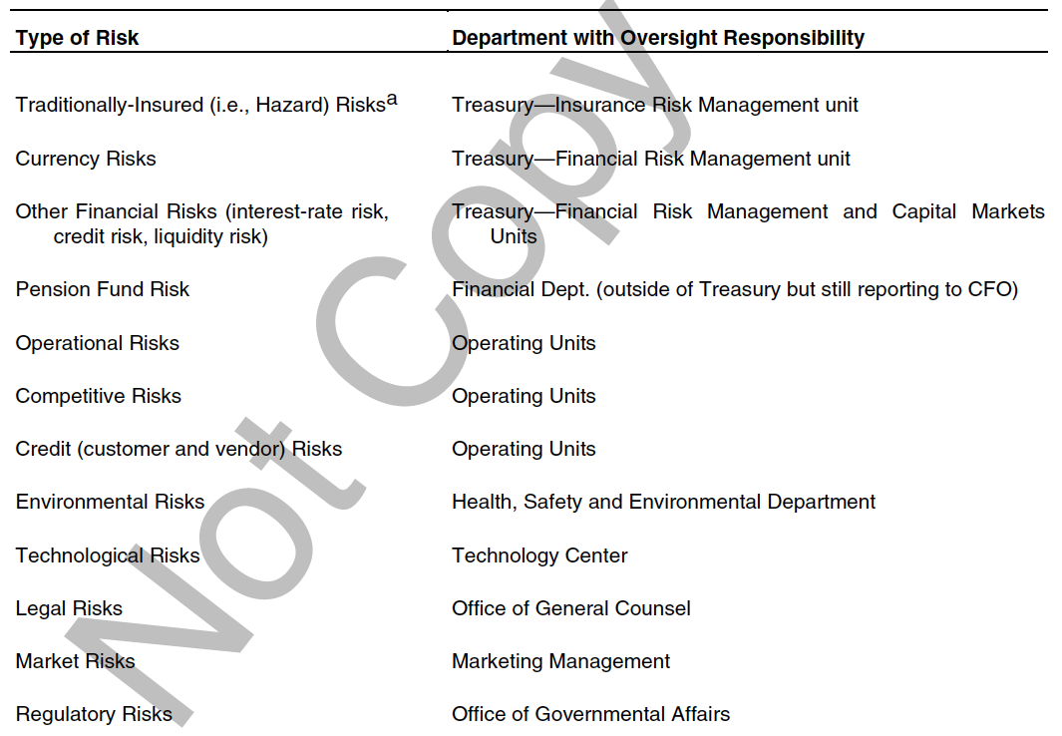
Current Risk Management Plan

Slide 4
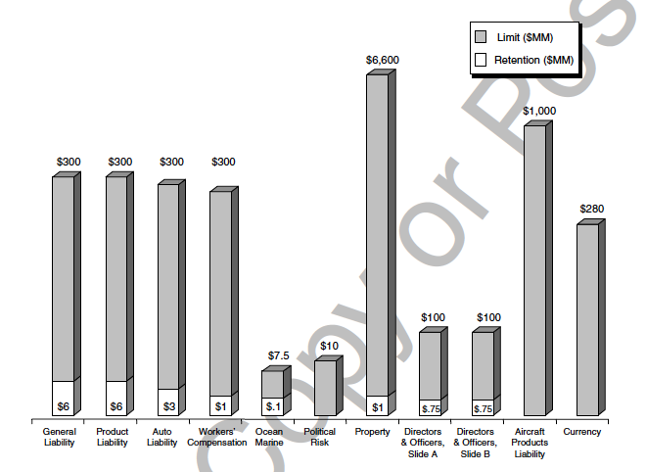

Slide 5
What is the goal of this risk management program?
Reduce the volatility of earnings.
Minimize the “Cost of Risk.”
“Cost of Risk” = Retention + Admin Expenses + Insurance and Option Premia.
Does this always achieve “Maximize Shareholder’s Value?” (not necessarily)

Slide 6
How is Exchange Rate Risk Currently Handled?
Option written on a basket of 20 currencies (85% of profits).
Long Put (at-the-money).
Strike = Blend of exchange rates.
Offered protection if U.S. Dollar strengthened.
Can walk away if U.S. Dollar weakens.
Matured Quarterly
OTC or Exchange-traded option? (OTC)

Slide 7
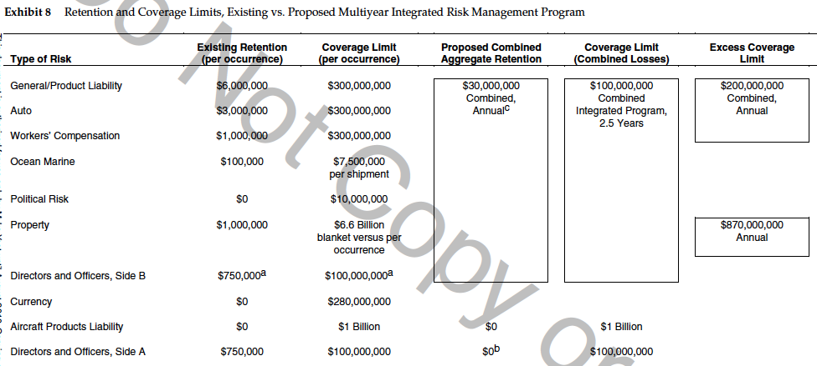

Slide 8
 | Pros | Cons
New Plan | One Issuer of Protection Only one deductible Lower Costs Lower Standard Deviation | What if the “one” insurer goes under (AIG!) New Idea – is it sound? Too Complicated? Are the deductibles and limits “correct?” Still not a fully-integrated “enterprise” risk program (but arguably a move in the right direction)

Slide 9
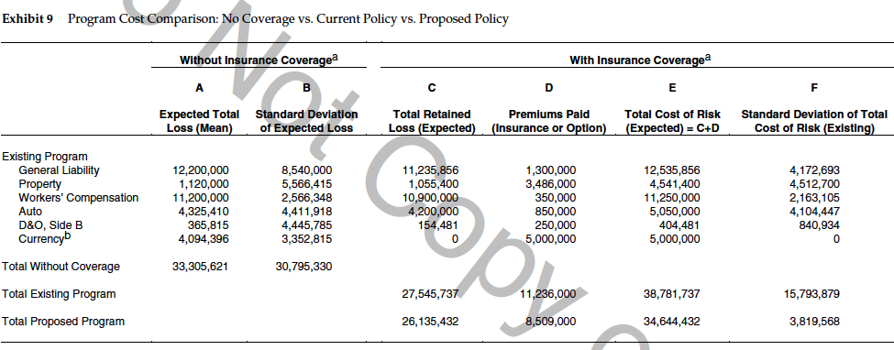

Slide 10
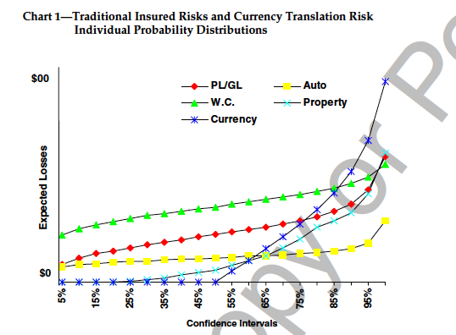
New Plan - Methodology

Slide 11
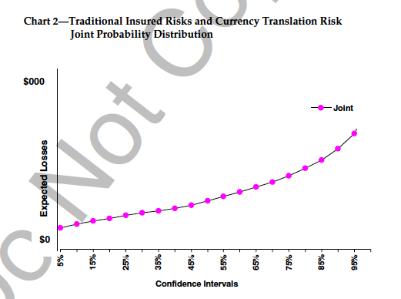
New Plan - Methodology

Slide 12
Why does plan cost less?
AIG is being charitable? (no)
AIG is passing on some economies of scale because they are just writing one contract (maybe a small amount of savings).
AIG is passing on savings from the gained benefit of diversifying their business into new areas? (probably not. They have plenty of other areas of insurance).
Portfolio Effect! Shift from individual risks mattering to an aggregate change of loss (risk). YES!

Slide 13
Old Plan | New Plan
“Portfolio of Insurance” “Portfolio of Options” | “Insurance on a Portfolio” “Option on a Portfolio”

Slide 14
$30 Million “Acceptable” Loss Example
Old Plan | New Plan
Risk 1 $10 million deductible Risk 2 $10 million deductible Risk 3 $10 million deductible | $30 million deductible for any claims from Risks 1, 2, or 3
Suppose there is a $25 million “Risk 1” claim, but no Risk 2 or Risk 3…. You will receive a $15 million payout with the old plan, but nothing with the new. Therefore cheaper to the insurer!

Slide 15
Another Interpretation: More insurance = Higher Premium
Portfolio of Options: Buy at-the-money puts on each stock
 | Today | Possible Outcomes in 1 year
Value of Stock A | $100 | $150 | $150 | $50 | $50 | $100
Value of Stock B | $100 | $50 | $150 | $75 | $150 | $100
Value of Stock Portfolio | $200 | $200 | $300 | $125 | $200 | $200
Payoff of Put on A | N/A | $0 | $0 | $50 | $50 | $0
Payoff of Put on B | N/A | $50 | $0 | $25 | $0 | $0
Combined Payoff of Both Puts |  | $50 | $0 | $75 | $50 | $0

Slide 16
Another Interpretation: More insurance = Higher Premium
Option on Portfolio: Buy at-the-money put on Stock Portfolio
 | Today | Possible Outcomes in 1 year
Value of Stock A | $100 | $150 | $150 | $50 | $50 | $100
Value of Stock B | $100 | $50 | $150 | $75 | $150 | $100
Value of Stock Portfolio | $200 | $200 | $300 | $125 | $200 | $200
Payoff of Put written on Stock Portfolio |  | $0 | $0 | $75 | $0 | $0

Slide 17
Another Interpretation: More insurance = Higher Premium
 | Today | Possible Outcomes in 1 year
Value of Stock A | $100 | $150 | $150 | $50 | $50 | $100
Value of Stock B | $100 | $50 | $150 | $75 | $150 | $100
Value of Stock Portfolio | $200 | $200 | $300 | $125 | $200 | $200
Payoffs from Portfolio of Options |  | $50 | $0 | $75 | $50 | $0
Payoffs from Option on a Portfolio |  | $0 | $0 | $75 | $0 | $0

Slide 18
Use the Black-Scholes Model to show that the new plan should be cheaper!
Suppose that you have the following:
Stock A:
Current Price $100; Standard Deviation 50
Stock B:
Current Price $100; Standard Deviation 50
Correlation Coefficient (rho) between A & B is 0 (like in the case)
1 share each of A and B are invested equally in your portfolio (weights = 50%)
Therefore, current portfolio value = $200
Risk-free rate of 6%
Recall: Var of a 2-asset Portfolio… Var = w_{A}²σ_{A}²+w_{B}²σ_{B}²+2w_{A}w_{B}σ_{A}σ_{B}ρ_{(A,B)}
Recall: Standard Deviation = Square Root of Variance

Slide 19
Use the Black-Scholes Model to show that the new plan should be cheaper!
Your mission: Protect the value of the portfolio. Must not drop below $200 one year from now (T = 1).
Calculate the Premium to be paid under the following scenarios:
Scenario 1: You decide to enter into two at-the-money options, one with A as the underlying asset and the other with B as the underlying asset.
Scenario 2: You decide to enter into one at-the-money option with the portfolio as a whole as the underlying asset.
Which is more expensive? The “portfolio of options” or the “option on the portfolio?”

Slide 20
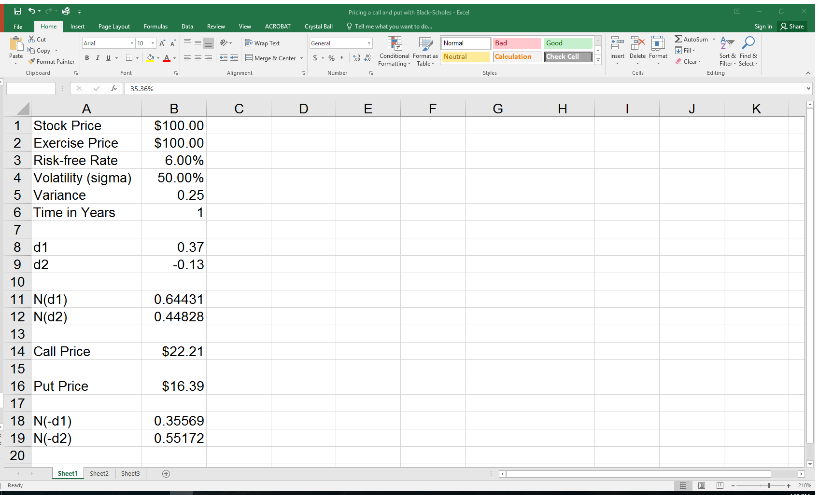
Scenario 1: Total Cost
European Put
Stock Price | 100
Strike Price | 100
Risk Free Rate | 6.00%
Expiration (in years) | 1
Volatility (standard dev) | 50.00%
Continuous Div Yield
 |  |  | -d1 & -d2 rounded |  | Pr (X≤x)
d1= | 0.37 |  | -0.37 |  | 0.3557
d2= | -0.13 |  | 0.13 |  | 0.5517
Put Price: | 16.38714932
2 Contacts…. 2 x $16.39 = $32.78

Slide 21
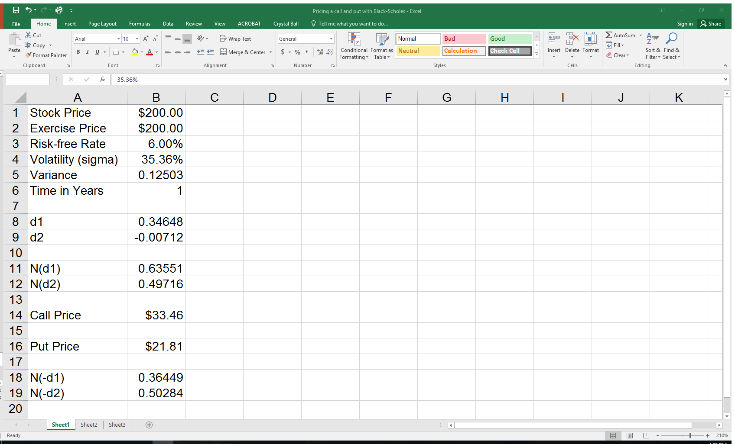
Scenario 2: Total Cost
European Put
Stock Price | 200
Strike Price | 200
Risk Free Rate | 6.00%
Expiration (in years) | 1
Volatility (standard dev) | 35.36%
Continuous Div Yield
 |  |  | -d1 & -d2 rounded |  | Pr (X≤x)
d1= | 0.346483258 |  | -0.3465 |  | 0.3645
d2= | -0.007116742 |  | 0.0071 |  | 0.5028
Put Price: | 21.8038415
Var = w_{A}²σ_{A}²+w_{B}²σ_{B}²+2w_{A}w_{B}σ_{A}σ_{B}ρ_{(A,B)} = (.5)²x(.5)²+(.5)²x(.5)²+2(.5)(.5)(.5)(.5)(0) = Var = 0.125 => sqrt(Var) = 35.36%

Slide 22
Likelihood of Plan Acceptance?
What actually happened?

