Slide 1
The Walt Disney Company’s Yen Financing

Slide 2
What is Walt Disney’s relationship with Tokyo Disneyland?
Had been open for about 2 years.
Operated by a separate company.
Sends royalty receipts to Walt Disney in Yen (¥8 billion recently).

Slide 3
What is the problem facing Walt Disney?
¥8 billion in royalty receipts received in current year.
Face exchange rate risk into dollars.
Yen has recently lost value against the dollar, so each Yen translates into fewer dollars when Walt Disney exchanges them.
Specifically, ¥229.78/$ to ¥248/$ in recent period.
Strong growth in royalty receipts (denominated in Yen) projected (10-20% per year).

Slide 4
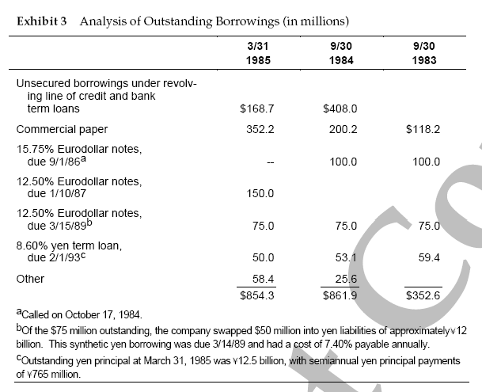
Disney’s Current Debt Load
Additional Goal: Reduce S-T Debt
What is a Eurobond?
Eurobond: an international bond denominated in a currency not native to the currency where it was issued.
Eurodollar
Euroyen
Euro ECU

Slide 5
Possible Solutions #1: Foreign Exchange Forwards
Pros:
Very common hedging instrument.
Can be executed at a fairly low cost for maturities extending 2 years.
Cons:
Longer maturities have higher costs (higher bid-ask spreads)
Dealers don’t like making any transactions of any substantial size very far into the future.
Bank foreign exchange forwards would use up more of Disney’s already heavily-drawn bank credit lines, since the banks would treat the forward contracts as part of their overall exposure to Disney. This might inhibit Disney’s further use of letters of credit to back up its commercial paper.

Slide 6
Possible Solutions #2: Currency Futures & Options
Pros
Futures contracts and put options on Yen are readily available
Cons
Standard futures contracts and options tend to have maturities that are less than one year.
Options have premiums up front that must be paid.
Contract sizes are small relative to Disney’s annual exposure of ¥8 billion or more.

Slide 7
Possible Solutions #3: Balance Sheet Hedges
Pros
Having a liability denominated in Yen would create a use for the Yen royalties (interest and/or principal payments).
Cons
Difficult to obtain such liabilities.
Domestic Yen Bonds – Foreign companies had difficult time issuing in Japan in 1980’s; also cumbersome process (1-3 months)
Euroyen Bonds – Japanese Foreign Minister regulated the use of Yen in international finance transactions. Only AA or better companies could issue (Disney was rated A-)
Conventional term yen loan – This one is possible (they already have one outstanding)

Slide 8
Possible Solutions #4: Currency Swap into Yen
Using Existing Dollar Debt
Problem – current dollar debt mature in 18 months and 44 months.
$50 million of the longer-maturity note had already been swapped into yen.
Using New Debt
This is what Goldman Sachs offers them… a ECU-denominated bond (new debt) that can be swapped into a Yen liability.
The money raised through the new debt can be converted into dollars and used to pay down short-term debt.

Slide 9
Swap Mechanics
=
Disney
Bond
(ECU)
French Utility Bond
(Yen)
Notional Values same at today’s spot exchange rate
Int Pmt #1
Int Pmt #2
Int Pmt #3
…
…
…
Int Pmt #1
Int Pmt #2
Int Pmt #3
…
…
…
French Utility pays Disney’s interest and principal (thereby “getting” Disney’s ECU borrowing rate)
Disney pays Counterparty’s interest and principal (thereby “getting” French Utility’s Yen borrowing rate)

Slide 10
Two Viable Options:
1. Yen Term Loan
2. Currency Swap using New Debt
Analysis Plan:
See what the cost is for each Debt Instrument
See which cost is cheaper
If the swap is cheaper, we’ll see how Disney benefits, how the French Utility benefits, and how the Swap Bank benefits.

Slide 11
The Yen term loan bottom of page 4 in case
¥15 billion ten-year loan, with principal repaid at final maturity. Interest of 7.50% paid semi-annually and front-end fees of 0.75%.
What is the “all-in” cost for Disney borrowing in Yen?
Solve for YTM of a bond with the following features:
Par = 100
Price = 100 – 0.75
Coupon = 100 * 0.075 / 2 = 3.75
N = 10 x 2 = 20
Rate = 3.804% x 2 = YTM = 7.608% (Bond Equiv Yield) ; (1.03804^2)-1 = 7.75% (Annual Equiv)

Slide 12
The Goldman Sachs Plan:
New Debt (exhibit 6):
ECU 80 million, with sinking fund
10-year Eurobonds @ 100.25% of par
9.125% annual coupon
2% underwriting fees
$75,000 additional fees
Currency Swap:
Swap into a Yen liability

Slide 13
Goldman Plan:
What is the “all in” cost for Disney Borrowing in ECU (The Euro ECU bond – pays annually)?
Expenses: $75,000 x (ECU 1/$.742) = ECU 101,078.17
Fees: 2.00% of par. So Price minus fees is 100.25% - 2.00% = 98.25%
(80 million ECUs) x (.9825) – 101,078 = 78.499 million ECUs
Annual coupon payments: (80 mill) x (9.125%) = 7.300 million ECUs
10-year amortization
Sinking fund starts in year 6

Slide 14
Disney Cash Flows IRR = 9.4727%

Slide 15
Interest Rate Differentials
 | ECU | Yen | Difference
Walt Disney | 9.4727% | 7.75%
French Utility | ? | ?
Difference

Slide 16
What is the Motivation for the French Utility?
Wants to swap them into ECU liabilities to match with its European currency receivables
Rated AAA.
French Utility already has Yen Bonds on its balance sheet.

Slide 17
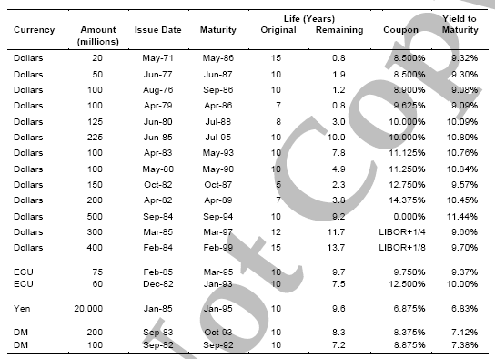
French Utility Cost of Debt Exhibit 8

Slide 18
Interest Rate Differentials
 | ECU | Yen | Difference
Walt Disney | 9.47% | 7.75% | 1.72%
French Utility | 9.37% | 6.83% | 2.54%
Difference | 0.10% | 0.92% | 0.82%

Slide 19
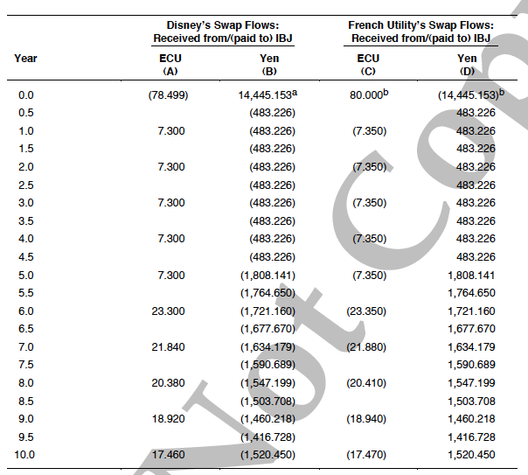
The Swap Exhibit 7

Slide 20
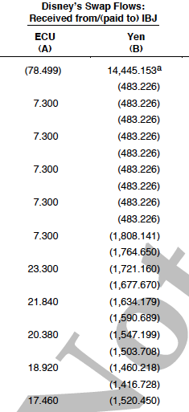
Disney’s Benefit
If you put column B in Excel, you’ll find a 3.446% semi-annual IRR. This means that the swap is allowing Disney to borrow “in Yen” at a 6.89% Bond Equivalent Yield (APR) or 7.01% Annual Equivalent (EAR).

Slide 21
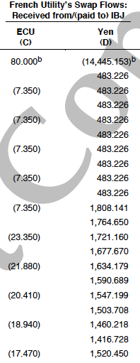
French Utility’s Benefit
Remember that the French Utility had an existing loan, so it didn’t actually swap principal payments. The (14,445.153) is actually (14,591.73) based on a 6.83% EAR yield. This makes the 80.000 ECUs actually 79.29 ECUs which results in an IRR for column C of 9.35%. This is slightly better than the 9.37% it could have borrowed ECUs at.

Slide 22
Interest Rate Differentials
 | ECU | Yen | Difference
Walt Disney | 9.47% | 7.75% | 1.72%
French Utility | 9.37% | 6.83% | 2.54%
Difference | 0.10% | 0.92% | 0.82%
SWAP | ECU | Yen
Walt Disney |  | 7.01%
French Utility | 9.35%

Slide 23
Bank’s Benefit

Slide 24
Bank’s Benefit in ECUs (millions)
Yr. 0 .005
Yr. 1 – 6 .05
Yr. 7 .04
Yr. 8 .03
Yr. 9 .02
Yr. 10 .01

Slide 25
Outcome
Disney did go ahead with the ECU Bond and the Swap into the Yen Liability
The Yen actually rose over the next few years, prompting critics to second-guess Disney’s decision to hedge its yen royalty stream.
Disney remained firm in its decision to hedge its royalties and issued Swiss Franc and Australian Dollar notes, both swapped into Yen Liabilities.

